Slide 1
Heath & Animal Welfare
Beginner Farmer Resources
Pastured Poultry Production
This presentation template was developed by NC Choices and project partners to be shared in full for educational purposes. NC Choices, funders, and project partners are not responsible for content selected or adapted outside of the original slide deck presentation. The project is supported by the Beginning Farmer and Rancher Development Program competitive grant no. 2018-70017-28550 of the USDA National Institute of Food and Agriculture.

Slide 2
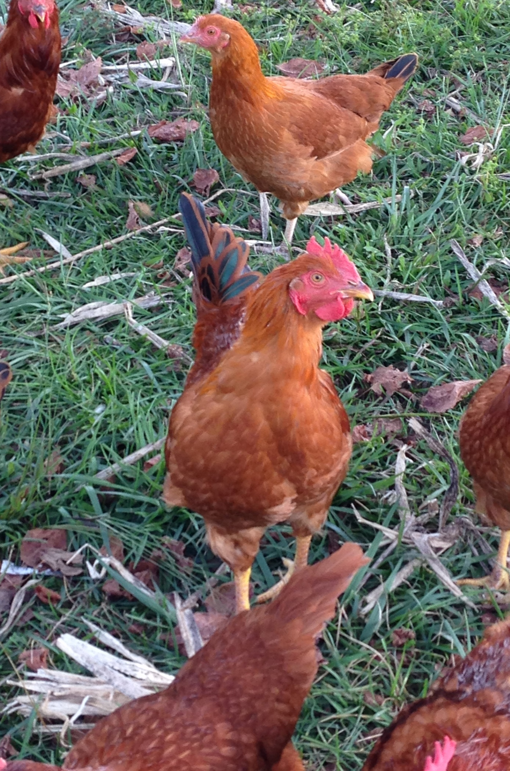
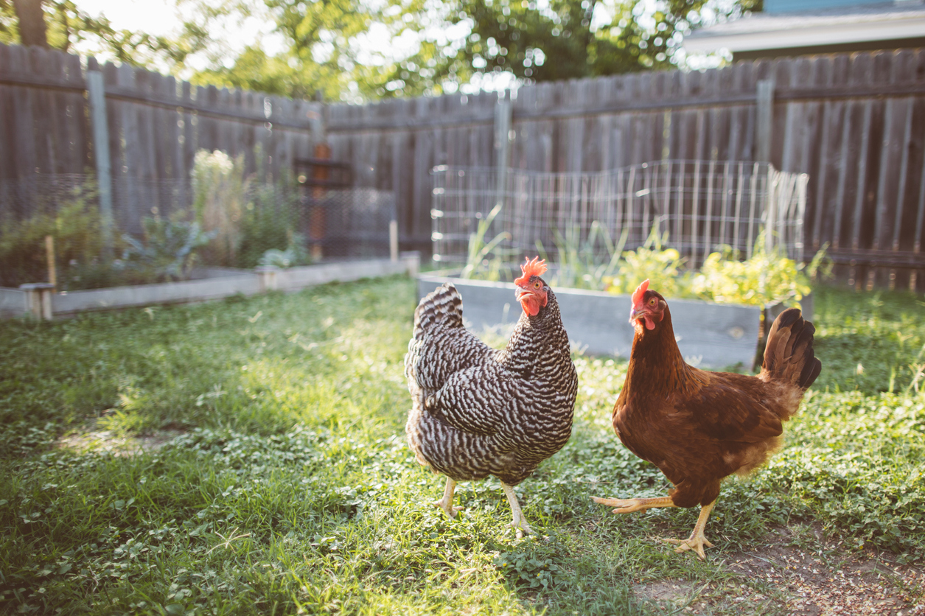
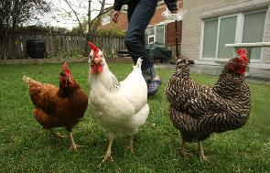
Healthy Bird
Notes:
These chickens and young rooster in the middle are standing up tall walking around, foraging, show no clinical signs of respiratory illness, gastrointestinal illness, or neurological issues. Growing normally, exhibiting normal behaviors. Eating, drinking normally. No eye problems. No problems with the combs or wattles. These are examples of healthy birds!
Photo Credit: UF/IFAS Blogs – University of Florida (left); Extension FYI – UW Extension (right)

Slide 3
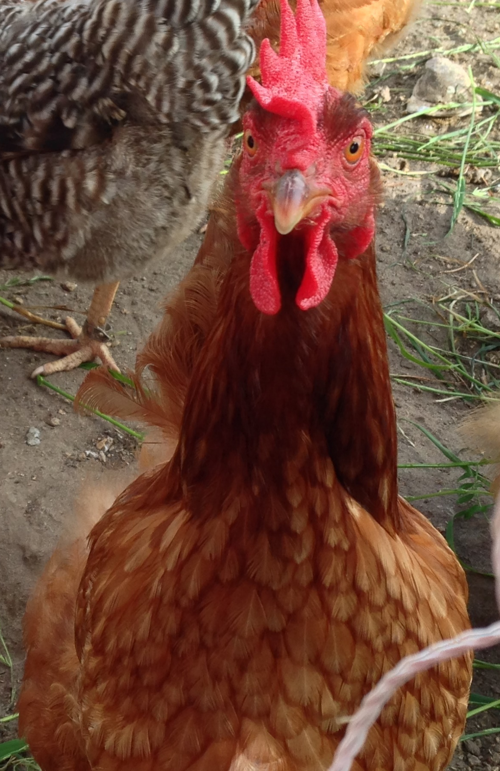
Disease Recognition
Due to economics, diagnosis of poultry diseases must often be made using a combination of history, symptoms and response to treatment as opposed to definitive laboratory tests.
Therefore learning the clinical signs of disease & routine observation of birds is crucial to recognition and diagnosis.
Notes:
There are a lot of different diseases out there in the poultry world and they are often not easy to diagnose or treat. Prevention is the best option, but if you do end up with sick birds, this presentation should give you a better grasp on what category of disease you may be dealing with, give you options for laboratory testing, and in the Management presentation of this series, we discuss biosecurity for further prevention discussion.
Because each individual chicken does not cost very much money in the grand scheme of things, and it is not cost-effective to send each bird off to the lab for testing every time you have one die; you often have to use the information at hand to determine the problem in your flock. Let’s discuss some broad topics of clinical signs of disease and how to routinely observe your birds to recognize illness.

Slide 4
Reservoirs of disease
Disease-causing organisms are generally found in live birds, in secretions of live birds, and freshly dead birds.
Rodents and insects can be reservoirs.
Most diseases are spread by humans.
Avoid sick birds, secretions from birds, and manage mortality to prevent infecting your birds.
Notes:
There are “reservoirs of disease” all over the place! Organisms that can cause disease are generally found in live birds or their secretions and are also still found in freshly dead birds. There are many other reservoirs as well, such as insects and rodents. Most diseases are spread by people in their clothing, shoes, or by visiting the same tractor dealership in your neighborhood. It is important to avoid sick birds and their secretions and to quickly and properly manage your mortality so you do not infect your other birds.

Slide 5
Carrier Birds
Birds that have recovered from a disease but can still shed the organism.
Quarantine can sometimes help you identify these birds.
(example: Salmonella)
Notes:
Birds can be “carriers” just like people can. This term refers to birds who have be exposed to the disease, become sick, have recovered, but can now still spread the organism to other uninfected birds. Quarantine is a good practice to help identify these birds. Don’t put previously sick birds right back in your regular pen with healthy birds, just because they are not presenting symptoms any longer. You need to give them time to fully shed the virus. It is also important to note that the virus, along with many other organisms, may live in the environment and soil for long periods of time, so it is important that your quarantine area be kept as clean and sanitary as possible as to not re-infect birds.

Slide 6
Other Concerns
Nutritional
Chemical toxins
Other toxins
Traumatic injury
Excessive stress
Predators
Notes:
There are also other concerns of disease you may have to manage in your flock whether it be nutritionally, toxins, injury (example: the neighbor’s dog or a predator), excessive stress (example: overcrowding in the chicken pen or heat stress), or predators.

Slide 7
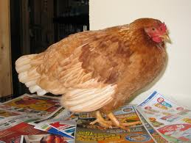
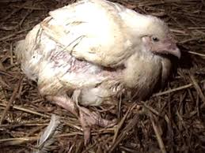
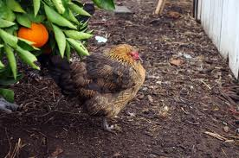
Look at your Birds!
Posture
Food consumption
Water consumption
Activity level
Egg production
Notes:
The best thing that I tell my backyard flock producers is to simply LOOK at your birds. They will tell you if something is wrong with them if you just pay attention long enough. Notice their activity level – do they seem to be happy and active? Or are they laying there and not moving and are listless? Are they all producing eggs on a regular basis to the best of your knowledge or have they stopped laying consistently? Are they eating and drinking water? Do they have normal posture? As you can see in these pictures, these birds all have different postures but none of them are normal. You should see your bird standing up “tall”, walking around with no feet and leg problems, eating, drinking, pecking in the grass or foraging, taking dust baths, laying eggs, etc. If you do not see these normal activities, you may have sick birds.

Slide 8
What to look for?
Respiratory disease: fluid from eyes and nares, shaking head, wiping face on feathers over wings, open mouth breathing, pale to blue color
Gastrointestinal disease: loose feces to diarrhea, discolored droppings, not eating, dirty feathers around vent
Central nervous system disease: unable to stand, head tilted, walking unsteady, unable to right self
Notes:
When trying to determine what might be wrong with your flock if they are sick, there are several different routes to consider. The first is respiratory disease – do they have any fluid coming from their eyes and nares (a chicken’s nose)? Are they shaking their head or wiping their face over their wings as though they are trying to clear their passageways? Are they panting and breathing with their mouth open? Do they have any discoloration? If any of these symptoms are present, you may be looking at a respiratory illness.
If you notice your birds have loose feces or diarrhea, any discoloration in their feces, very dirty feathers around their vent (rectum), or they are not eating, you may be looking at some type of gastrointestinal disease in your flock.
Lastly, if symptoms are presenting as a nervous system disease, you’ll see they are not able to stand or are wobbly when they walk, are unable to right themselves, are tilting their head, or any combination of these symptoms.

Slide 9
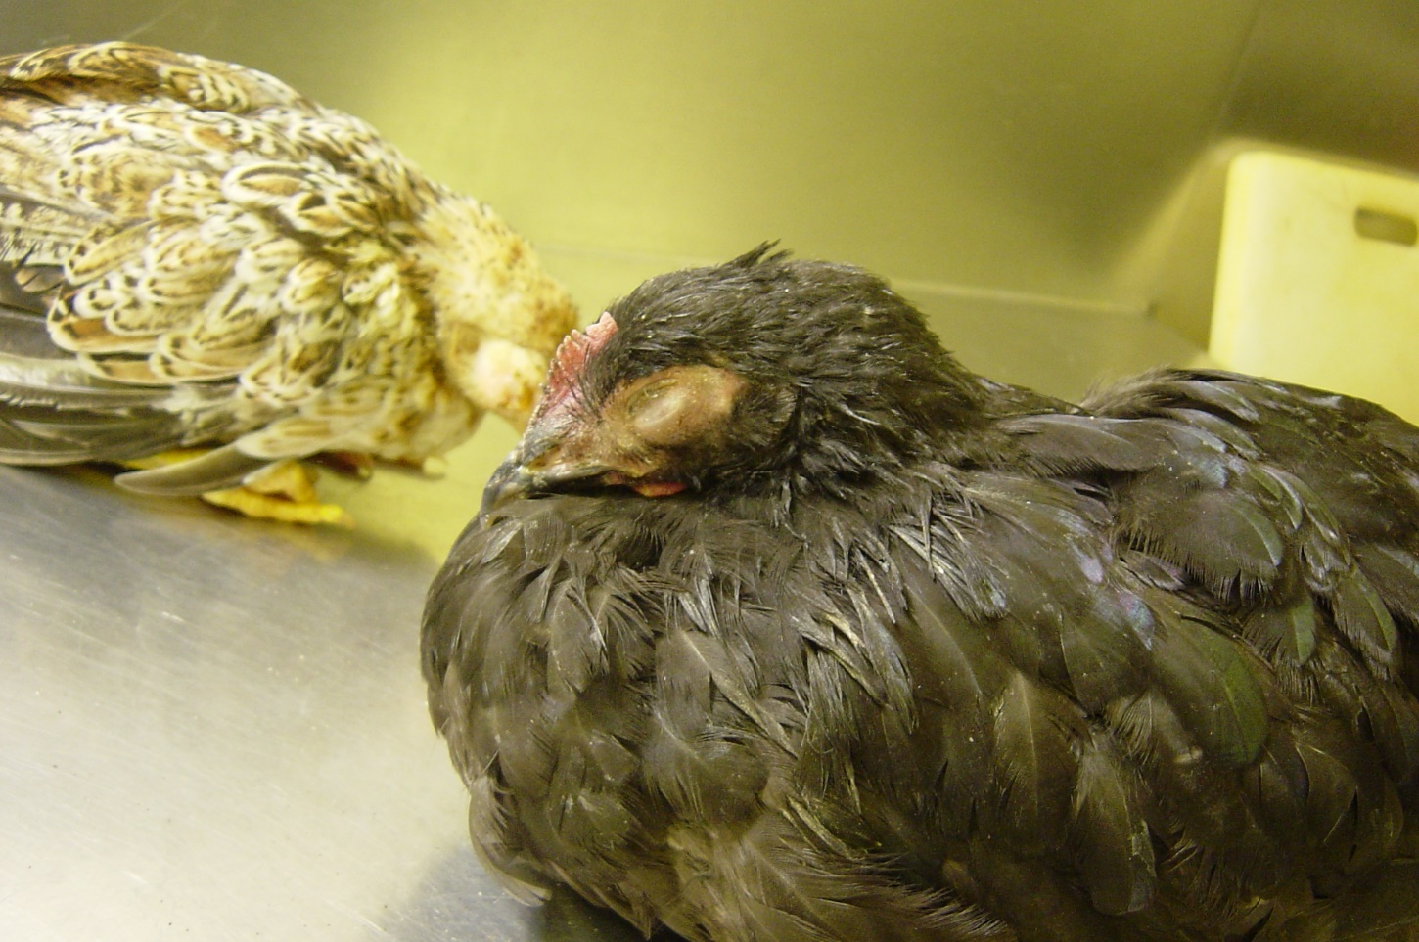
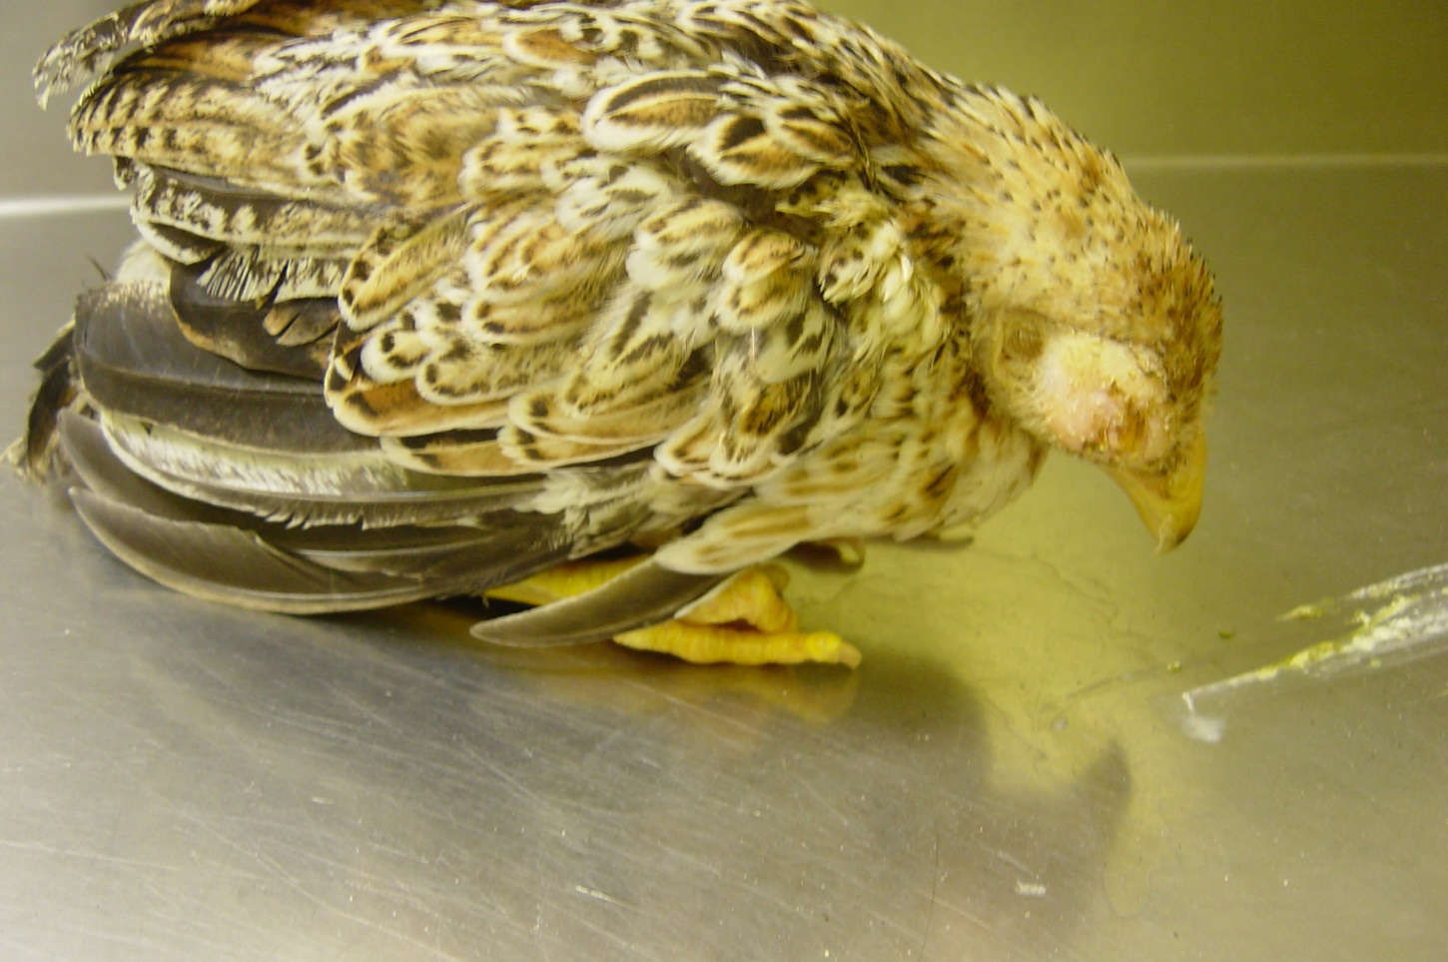
Disease Symptoms - Body
Combs & Wattles
Eyes
Nasal passages
Wings
Legs & Feet
Swelling, discolored
Cloudy, drainage
Discharge, color
Drooping
Color, scales, physical injuries
Nasal Discharge, Frothy, Crusty Eyes
Notes:
Here is a quick way to eliminate or acknowledge disease symptoms in your flock. Are the combs and wattles discolored or swollen? Are the eyes draining and cloudy? Are the nasal passages of the bird discolored or producing a discharge? Are their wings drooping? Are their feet and legs scaly, discolored, or do they have physical injuries? Taking what we know from the last slide, this gives you a quick way to decide what type of disease category you’re dealing with.

Slide 10
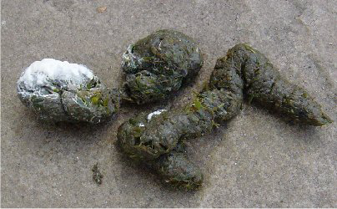
Disease Symptoms – Behavior
Walk or Gate
Appetite
Thirst
Movement
Coughing, Sneezing
Breathing
Slow or difficult
Eating normally?
Change in drinking
Normal activity level?
Snickering, rattling
Panting or gasping
Disease Symptoms - Feces
Change in color, frequency or consistency
The presence of blood, or mucus
Photographs by Jacquie Jacob UK Cooperative Extension Service
Notes:
You can also observe your flock’s behavior to determine if they are healthy or if they may have something going on. Is their gate slow or difficult or are they moving about freely? Is their appetite normal? Their water intake? Is their movement consistent with a normal activity level? Are they coughing and sneezing? If so, does it appear to be even more severe in that they’re rattling or snickering when they cough or sneeze? Are they panting or gasping for air when they’re breathing?
You can also look at your chicken’s feces to determine a potential problem. If you see a change in color, frequency or consistency or notice the presence of blood or mucus, you may have a gastrointestinal problem.

Slide 11
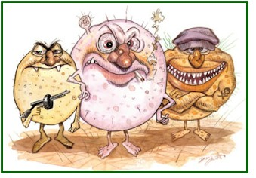
Microorganisms
Any disease that is transmissible or contagious
Bacteria
Viruses
Fungi
Mycoplasmas
Protozoa
Parasites
Notes:
There are lots of types of microorganisms – any diseases that are transmissible or contagious. We are going to discuss the types of parasites in this presentation.

Slide 12
Parasites
Organisms that live on other organisms (hosts) without providing any benefit in return.
External parasites
Internal parasites

Slide 13
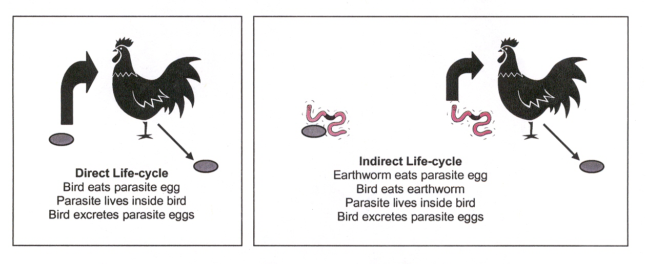
Internal Parasites
Live inside birds
Some can be seen with unaided eye
Two main types of life cycles
Notes:
If you have a sick flock, internal parasites may be one reason why. They live inside the birds and have two main life-cycles. The direct life-cycle which is where the bird eats the parasite egg then the parasite lives inside the bird and lastly the bird excretes the parasite egg and the whole process starts all over again. The other main life-cycle is the indirect life-cycle, where an earthworm eats a parasite egg and then the bird eats the earthworm and the rest of the cycle is the same as the direct life-cycle from this point. Once you have parasites in your environment, it is very hard to get rid of them as they can live a long time. Some of these can be seen with the naked eye, in the feces of the bird. For this presentation, we will not go in depth into all the types of internal parasites, but know that your local Extension livestock agent is there to help if you need them to help you identify a problem with your backyard flock.

Slide 14
External Parasites
Parasites that live on the skin, shanks, feathers
Fleas, bed bugs, lice, mites, flies, mosquitoes, ticks
Primarily cause mechanical damage
Cause long-term decline in health
Tissue/feather damage is visible, nits and bugs can also be visible
Notes:
External parasites can be a problem in backyard flocks. They are parasites that live on the bird’s skin, shanks, or feathers. Some examples are fleas, bed bugs, lice, mites, flies, mosquitoes, and ticks. They can cause a long-term decline in health, but mainly cause damage to the skin of the animal. Feather and tissue damage can be seen. Some external parasites can be seen as well. I like to tell my clients the easiest way to see external parasites is to get your friendliest chicken, in very good light (daylight or under a light) and very quickly (but gently) brush their tail feathers backwards. If they have mites, you will see them moving on their skin trying to get out of the light. They can be very pale, cream-colored, almost the color of the bird’s skin if it is a light-colored bird. If you can identify what the problem is, it is a lot easier to treat.
Don’t forget it is very important for your birds to have a place to take a dust bath. This helps them throw dirt onto their skin and rid of mites, and it serves as a preventative ”bath”. This is how they clean themselves, along with preening their feathers (cleaning their feathers).

Slide 15
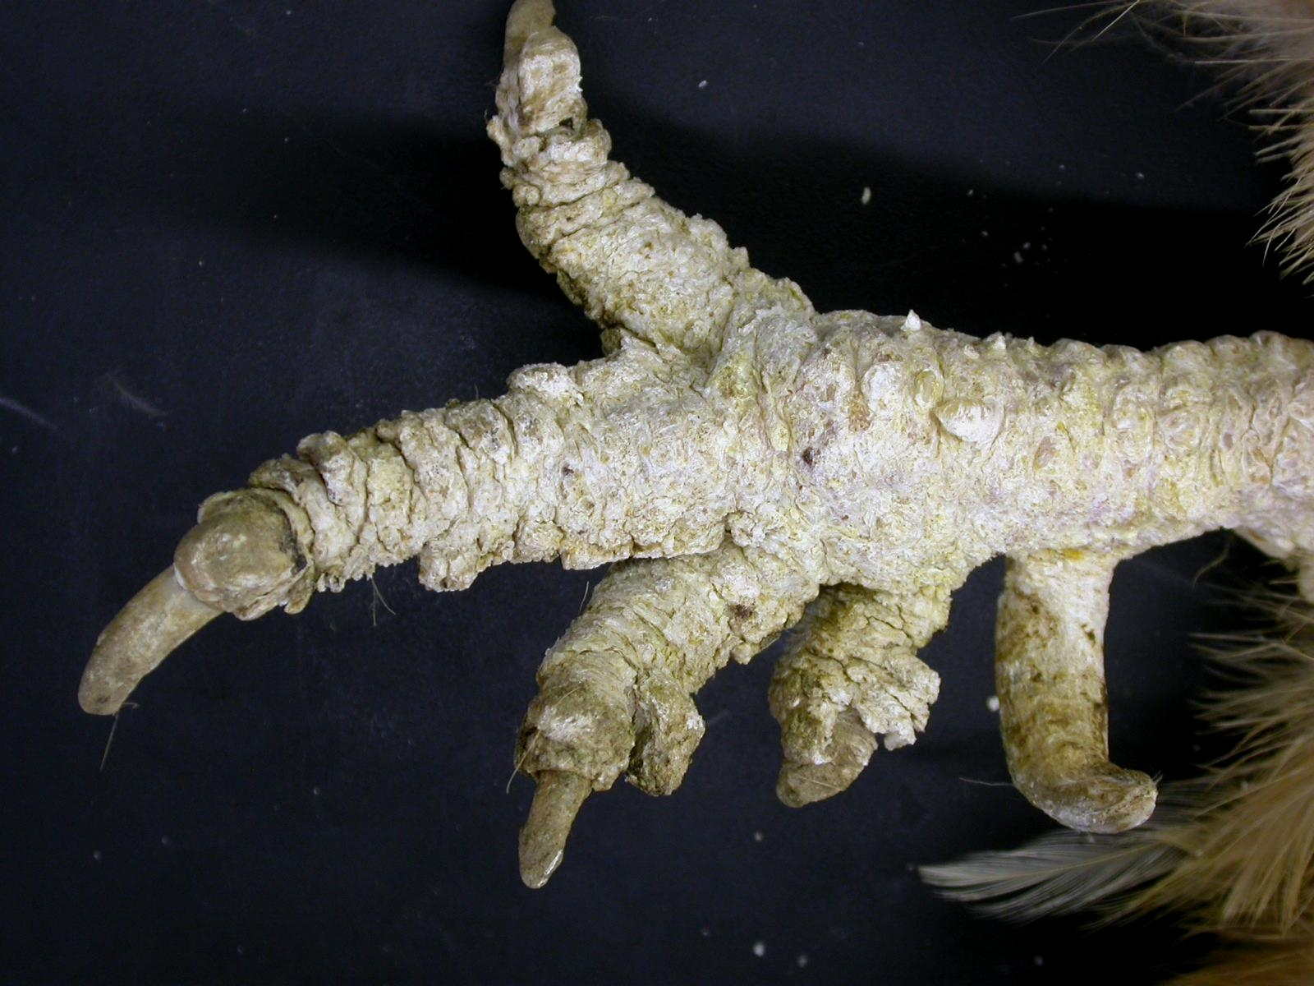
Scaly Leg Mites
Treatment:
Petroleum jelly or vegetable oil. Acts as a smothering agent. Reapply as needed.
Notes:
Let’s talk about some examples of external parasites. Scaly leg mites live on the shanks of the birds and are easily smothered by using petroleum jelly or vegetable oil. This can be reapplied as needed. The key in this case is that hopefully your birds are friendly and will let you handle them to apply the petroleum jelly or vegetable oil.

Slide 16
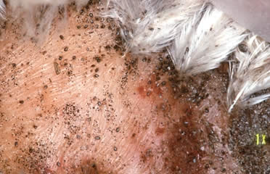
Northern Fowl Mite
Treatment:
Permethrin – apply in houses, roosts, floors, interior surfaces.
ALWAYS READ LABELS.
Notes:
Northern Fowl Mites also live on the outside of the skin as you can see in this picture. The treatment for this mite is Permethrin. It can be applied in houses, on roosts, on the floors, and interior surfaces of your chicken areas. ALWAYS read labels before use and be VERY careful with withdrawal times for egg consumption.

Slide 17
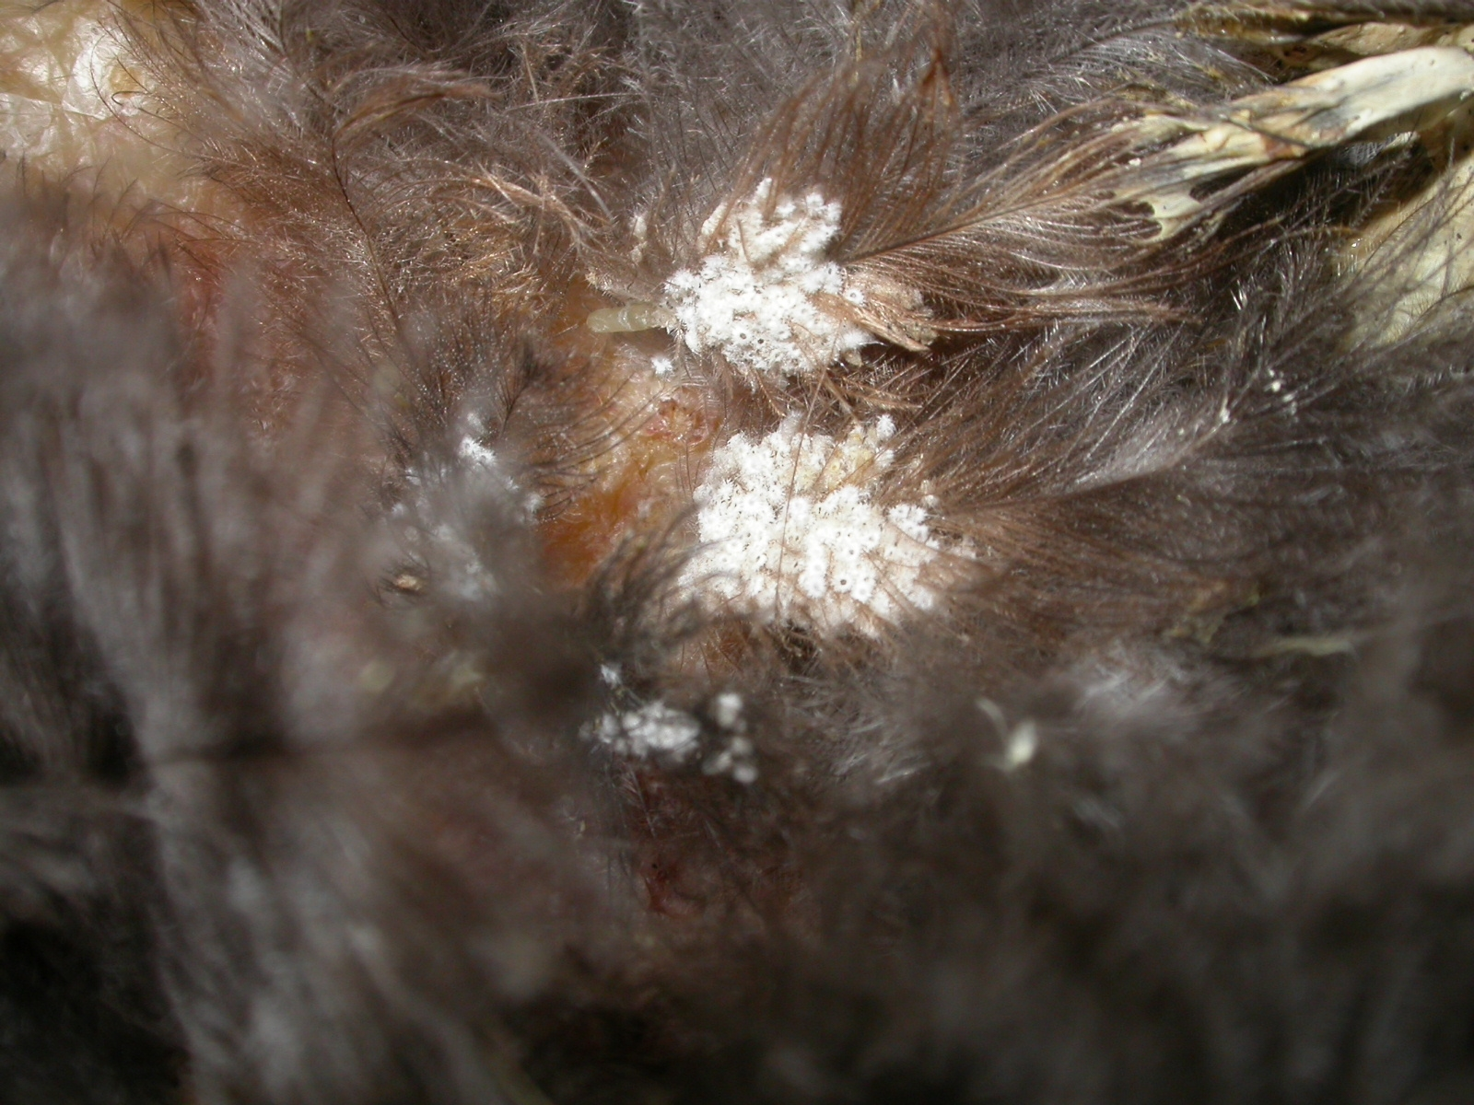
Lice Eggs
Treatment:
Permethrin – apply in houses, roosts, floors, interior surfaces.
ALWAYS READ LABELS.
Notes:
Lice eggs are found in clumps like seen in this picture here. They are pretty easily identified. Same treatment for lice eggs as for the Northern Fowl Mite - Permethrin.

Slide 18
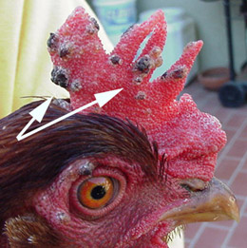
Fowl Pox
Treatment:
None, but you can vaccinate. Disagreement on value of vaccinating after an outbreak.
Notes:
We’ll talk about a couple of other flock problems now. Fowl pox is shown here. It looks like raised bumps on the chicken’s comb. It is a little more complicated than the previous problems. You can vaccinate but there is disagreement in the poultry world of if this really works and what the actual value is of vaccinating after an outbreak. It is always best to contact your Extension agent and / or if you’re in an area where there is a veterinarian who will see poultry, to confer with them.

Slide 19
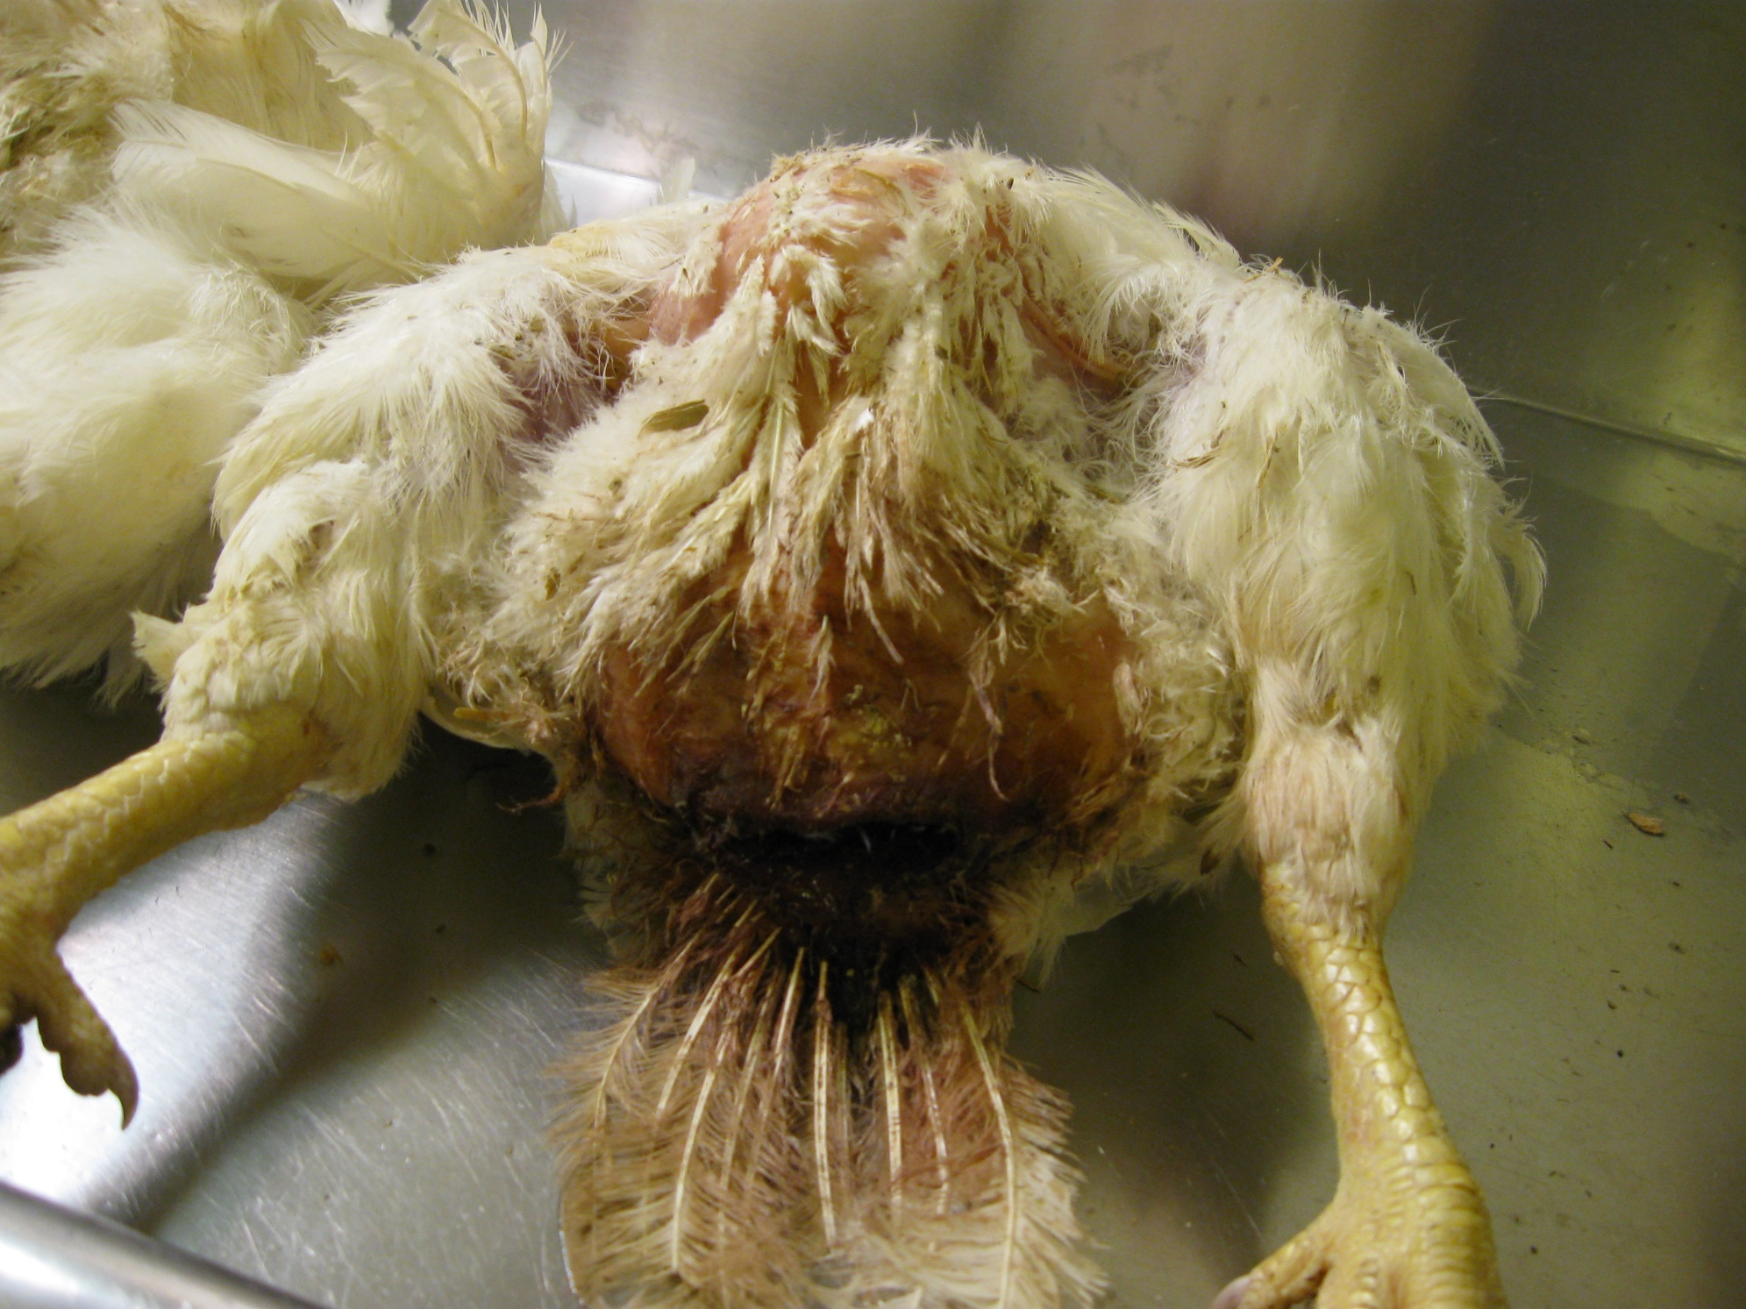
Vent Pecking - Trauma
Treatment:
Preventative. Plenty of space, proper nesting boxes, proper lighting, removing problem birds.
Notes:
Vent pecking is a behavioral issue and is best prevented. If the birds have plenty of space, proper nesting boxes and spacing, and proper lighting, there is typically not a problem with vent pecking in a flock. However, once it starts, it is hard to stop and problem birds should be culled (removed from the flock - if you can identify them).

Slide 20
Egg Production Changes
Infectious diseases generally cause a sudden drop in eggs – pay attention to this!
Soft shelled eggs
Wrinkled eggs
Inactive reproductive tract
Day length
Egg bound
Peritonitis
Prolapse
Age
Notes:
You may also notice changes in egg production within your flock. There are many factors that could cause a change in egg production – infectious diseases generally cause a sudden drop in eggs so it is important to pay attention to your flock’s egg production; you may also see soft or wrinkled eggs due to a disease. Your chickens may have an inactive reproductive tract. Chickens need about 16 hours of light a day to lay eggs, so day length can definitely affect how they lay. You could have a chicken that is egg bound meaning she has an egg stuck in her oviduct, peritonitis (a condition that occurs after a prolapse – this happens when the yolk goes into the abdominal cavity, when it is supposed to be going down the oviduct), a uterine prolapse (a collapse of the uterus), or age. Peak production for hens is about 32 – 36 weeks of age, so if your flock is much older than that – say 5 years old – they will not be consistently laying for you at that time.

Slide 21
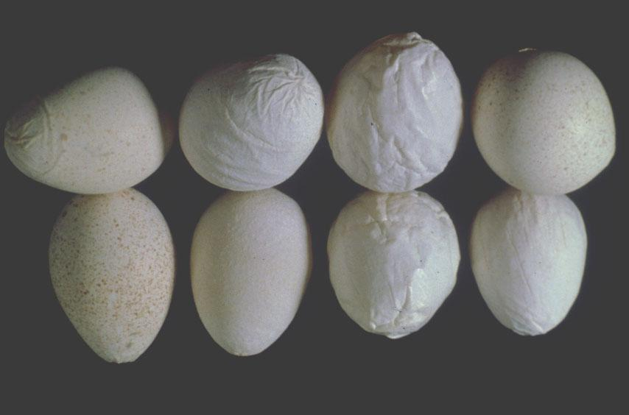
Notes:
Here is an example of misshapen or wrinkled eggs.

Slide 22
Reportable Diseases in NC
Salmonella gallinarium
Salmonella typhoid
Infectious Laryingotracheaitis
Mycoplasma gallinarium
Mycoplasma synoviae
Avian Influenza
Avian Chlamydiosis
Avian Encephalomyelitis
Paramyxovirus
Virulent Newcastle Disease
West Nile
Notes:
There are many diseases that are reportable to the North Carolina Department of Agriculture including several you will recognize – Salmonella (a major player in foodborne illness), Mycoplasma, Avian Influenza, Virulent Newcastle Disease, and West Nile. If your flock tests positive for any of these diseases, you must report them to the state.

Slide 23
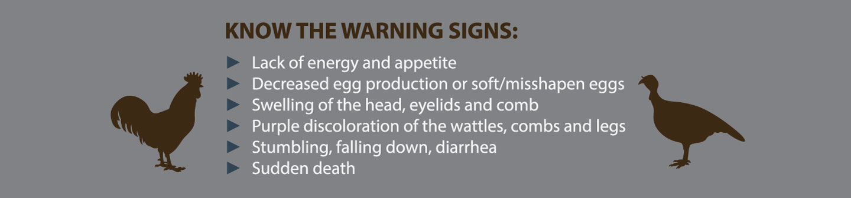
Avian Influenza
Check current status here: http://www.ncagr.gov/avianflu/
Notes:
(Copied from NCDA website)
Influenza in poultry falls into two groups: low pathogenic avian influenza (LPAI), or highly pathogenic avian influenza (HPAI). Similar to influenza symptoms in people, birds infected with LPAI usually experience only mild signs if any, including respiratory signs such as conjunctivitis and nasal discharge, ruffled feathers or a drop in egg production. Unlike LPAI, the first indication of HPAI in poultry is sudden death, often without signs of illness. In the last 40 years, there have been introductions of LPAI across the country, all of which have been successfully eliminated.
NCDA&CS has worked with the poultry industry and other state and federal agencies to prepare for and respond to introductions of influenza in poultry. The state’s voluntary cooperative control plan includes education, monitoring, reporting and response. Testing for influenza in poultry is conducted through our Animal Disease Diagnostic Laboratory system. Commercial and non-commercial poultry flocks are routinely monitored for influenza.

Slide 24
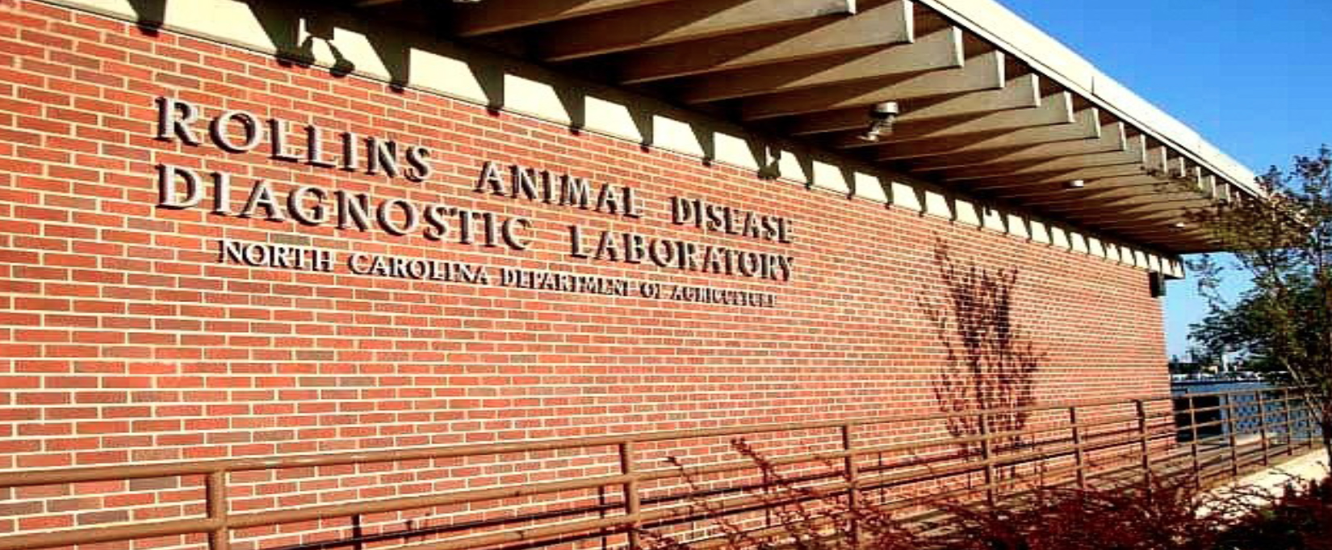
Diseases
Use the diagnostic lab services when unsure of cause or multiple birds are sick
A fresh mortality or bird must be used for necropsy
Web: http://www.ncagr.gov/vet/ncvdl/
Phone: (919) 733.3986
Notes:
One of the only true ways to diagnose a problem in your flock is to send a bird off to be tested. A fresh mortality or a live bird works best because you want the tissues to be as fresh as possible. This makes it a lot easier on the veterinarians and staff at the laboratory to diagnose a problem in your flock. If you send them a bird that has been dead for three weeks, you will likely not get an accurate diagnosis. Here is the contact information for the Rollins Animal Disease Diagnostic Laboratory in Raleigh. There are several North Carolina Department of Agriculture labs across the state; this one is the most centrally located. If you need any help with sending your bird to the lab, or would like pricing information for this service, you can use the contact information here or contact your local Cooperative Extension livestock or poultry agent. They will be happy to help you find the best route to get your birds to the lab to determine the problem.

Slide 25

Biosecurity
Always wash hands after poultry work
Shower & change clothes before mingling with other poultry owners and before returning to your flock
Use boot covers & coveralls or a dedicated set of clothes & shoes

Slide 26
Thank you!
Are there any questions?
MAJOR CONTRIBUTORS:
Dr. Donna Carver for slides and pictures
Richard Goforth for slides and pictures

