Slide 1
Welfare, Health and Biosecurity
Beginner Farmer Resources
Pastured Pork Production
Silvana Pietrosemoli
This presentation template was developed by NC Choices and project partners to be shared in full for educational purposes. NC Choices, funders, and project partners are not responsible for content selected or adapted outside of the original slide deck presentation. The project is supported by the Beginning Farmer and Rancher Development Program competitive grant no. 2018-70017-28550 of the USDA National Institute of Food and Agriculture.

Slide 2
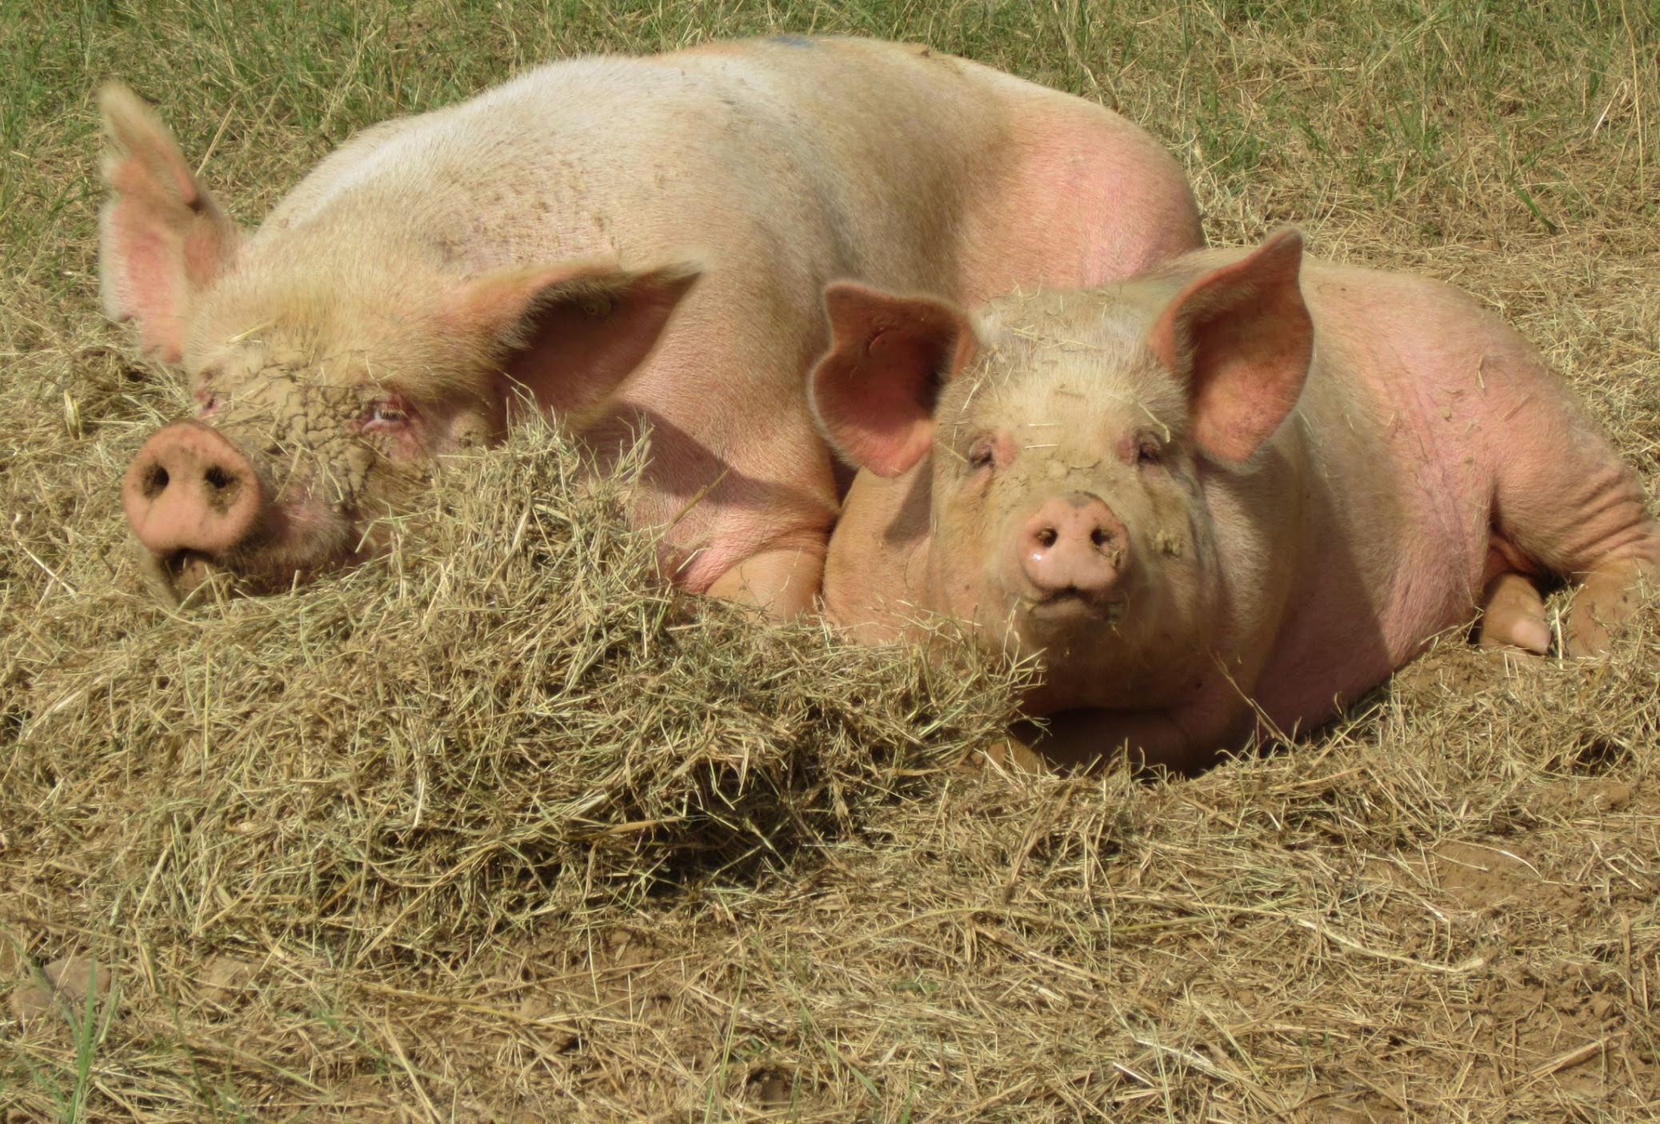
Avoid Stress- Happy pigs are healthy pigs!
Factors that may cause stress
Disease
Inadequate water/feed
Overcrowding
Extreme temperatures/weather
Movement, mixing, fighting
Verbal or physical abuse
Production stage-farrowing or weaning
Changes in the environment e.g. changes in housing
Notes:
Stress is a condition which occurs in all pigs when confronted with adverse management and environments. Better management practices= less stress
Low levels of selenium or vitamin E may increase the susceptibility to stress. High levels of vitamin A.- Important to have balanced rations
Stress effects
Depresses immunity & makes them more susceptible to disease
Decreases feed and water intake which decreases growth rate and feed efficiency
Decreases the pigs ability to cope with environmental changes- stressed pigs are more affected by weather
Bottom-line -stress costs money by decreasing performance. Happy pigs= more profitable pigs!

Slide 3
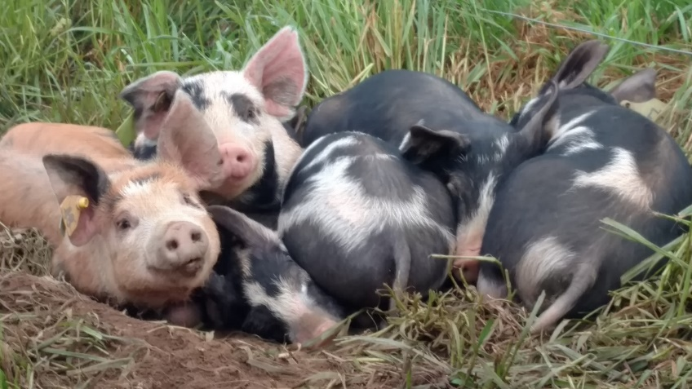
Good Animal Husbandry-Welfare
Includes health, environment conditions and biosecurity measures.
Strategies
Provide an appropriate environment
Proper nutrition for stage of production
Biosecurity – minimize risk of disease
Monitor for signs of sickness and administer appropriate treatment as needed
Minimize stress at transport
Handle animals appropriately and safely
Notes:
Use good biosecurity measures to prevent disease
Look for signs of sickness.
Monitor regularly.
Observe animals more often during times of stress to identify issues early

Slide 4
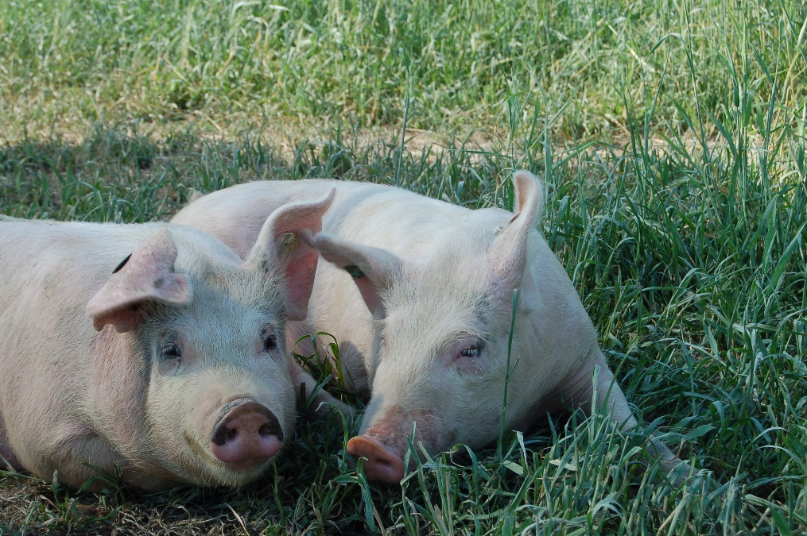
Stress and low immunity could predispose animals to suffer physiological alterations and diseases
Producers should be able to recognize sick animals, and support health practitioners in the treatment
Signs to pay attention to:
Body condition (individual and average of the group)
Animals with shaggy hair
Cough
Abnormal fecal matter,
Abnormal behavior (Isolation, lack of appetite)
Higher than normal body temperature
Discharges (nasal, ocular, vulva)
Decrease in the average daily gain
Diseases can present in both clinical and subclinical forms. Subclinical signs are harder to identify (decreased appetite, weight loss, poor feed conversion, poor performance).
Notes:
Swine are generally hardy animals, but they are susceptible to a variety of diseases.
A normal pig
Alert, active, curious, vocal
Good appetite, has fine hair, clean skin of good colour with a “bloom”,
Clear bright eyes, moist nose, curly tail, and warm ears
An unhealthy pig
Poor appetite or off feed,
Lethargic
Dull eyes, dry nose, cold ears and the tail is straight.
Sunken flanks, protruding backbone, diarrhea/constipation
Erratic breathing, shivering, rapid weight loss, coughing, swollen joints, and discharges
May separate itself from the group.
The major swine diseases are erysipelas, leptospirosis, pneumonia, porcine reproductive and respiratory syndrome (PRRS), pseudorabies, rhinitis, and transmissible gastroenteritis (TGE).

Slide 5
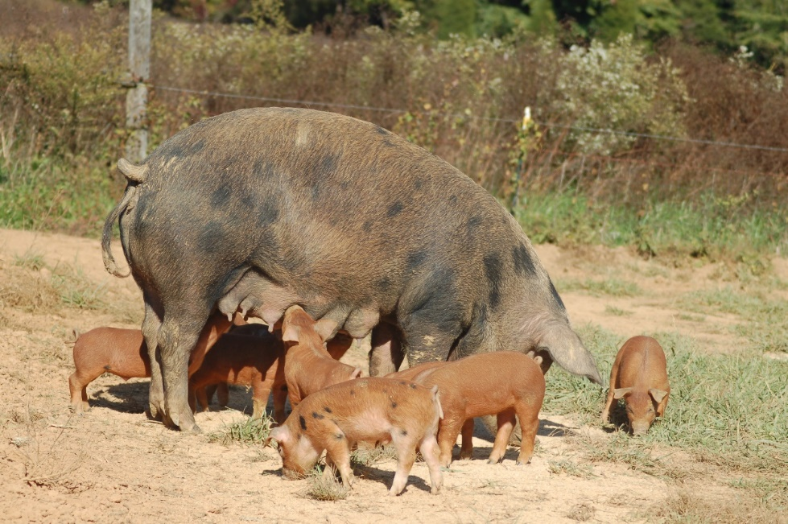
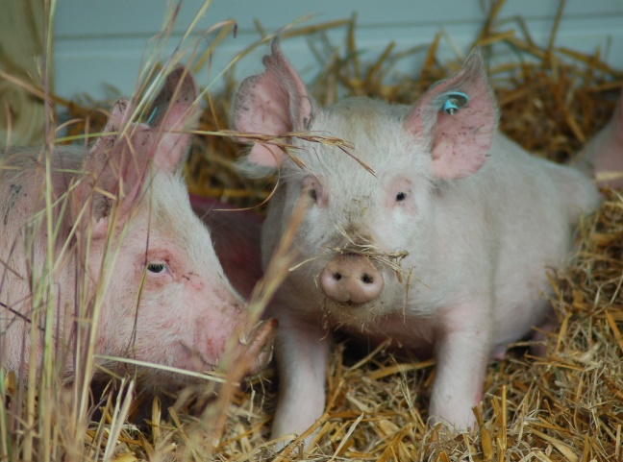
Diseases
Caused by viruses, bacteria, fungi, and parasites
Most can be controlled with a good vaccination program
Develop a vaccination program for your program
Some pig diseases can affect humans, --Ringworm- Lepto- Strep- Salmonella- --Influenza- E. Coli
Diseases = reduced productivity
  Gains
  Litter size
Know the diseases present in the area and which production stages are affected.
Notes:
Pigs kept outdoors tend to have a relatively good health due to low stocking density.
Transmission of diseases is primarily by direct contact, ingestion, indirect contact with insect vectors and contaminated inanimate objects, or inhalation of aerosolized materials
Diseases are costly:
Need for medication & additional labor costs
Decreases in growth rates and feed efficiency
Increased mortality and cull rates
Can lead to loss of markets and mandatory quarantine

Slide 6
Piglet diarrhea chart
Age | Aspect of faeces | Cause
day 1-4 | Watery yellowish | E. coli
day 1-14 | Bloody | Clostridium perfringens type C
2-4 weeks | Watery to pasty | Rotavirus
ALL | Profuse watery | Coronavirus (TGEv and PEDv)
Day 5-21 | Watery yellowish | Coccidiosis (Isospora)
5-6 weeks | Watery yellowish | E. coli
6 weeks to adult | Pasty dark | Brachyspira hyodysenteriae
TGEv Transmisible Gastroenteritis
PED Porcine Epidemic Diarrhea
Source: Pig progress
https://www.pigprogress.net/Piglets/Articles/2018/9/A-good-startis-vital-for-healthy-piglets-332838E/?intcmp=related-content

Slide 7
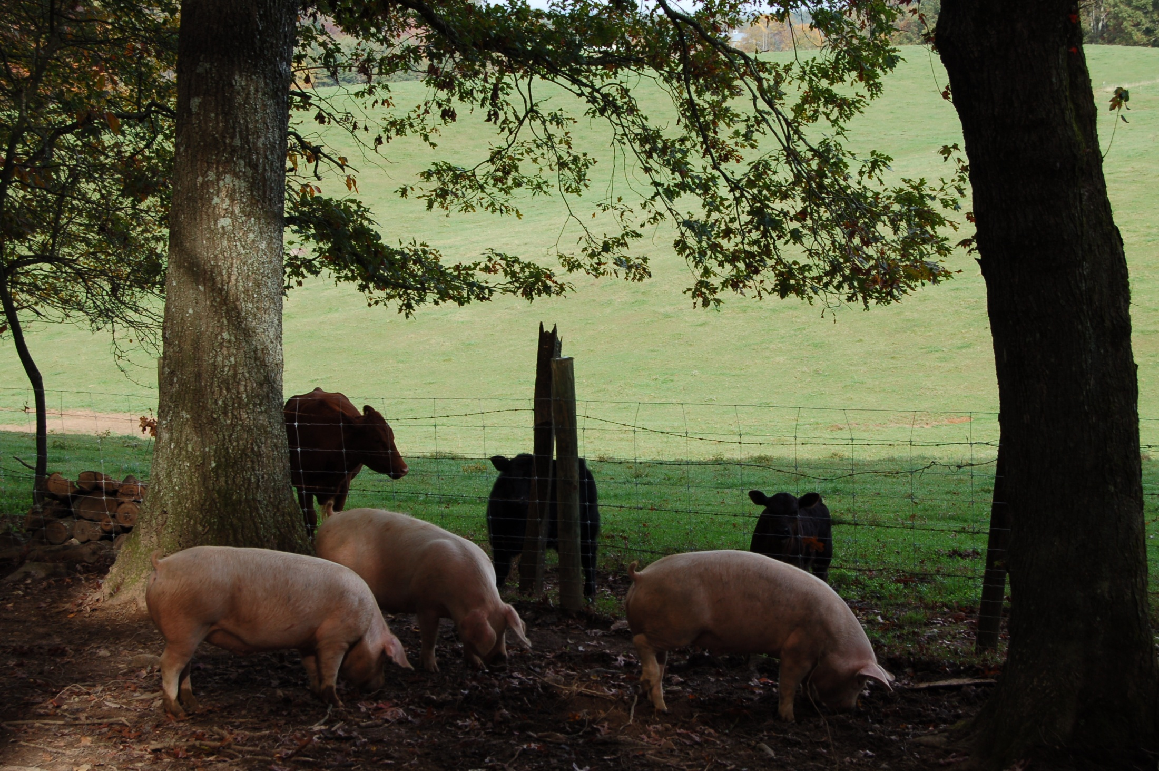
Biosecurity measures- minimize threats
Transmission risks
Within the farm- Animals/equipment/people
External threats- Animals/equipment/people
Manure
Clothing/ equipment/ tools
Wildlife-Birds, insects, rodents, animals
New animals
Breeding animals- STDs
Pastures
Overstocking
Water /feed
Notes:
The list of how disease can spread is long – from the movement of animals, wildlife, people and machinery, to contaminated feed, water, breeding, and bedding. Effective biosecurity is about being aware of the ways diseases spread and taking every practical measure to minimize the risk of spread and to prevent disease sources from entering your farm.
Limiting your farm and its inhabitants from contact with disease-causing agents through managing stock movements, controlling access, good on-farm hygiene, and in some cases an effective vaccination program
Good biosecurity measures are an investment-
ensure your livestock remain healthy
improve your farm’s efficiency, through higher productivity
treatments and labor to separate/ treat sick animals costs money
some diseases can lead to loss of markets or even forced quarantine
Transmission risks:
Manure – disease passed through manure
Clothing, equipment, tools, trucks
Wildlife-Birds, insects, rodents, animals – proper fencing, keep animals out of feed storage- wild pigs can spread diseases like brucellosis & pseudorabies
New animals- properly quarantine animals before introducing them to herd
Breeding animals- STDs – get animals from reputable producers
Pastures- rotate pastures with rest periods to break life cycles of pest
Overstocking- allows diseases to pass more readily between animals
Water/ feed- keep feeders & waterers clean and use fresh potable water and quality feedstuffs

Slide 8
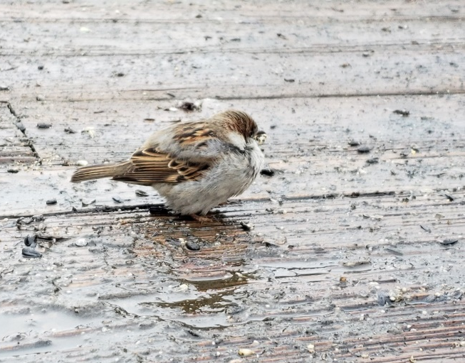
Biosecurity for small herds
Strategies
Maintain strong perimeter fencing
Consider double fencing & buffers for sensitive/high risk areas
Ship/receive pigs from the perimeter of farm
Quarantine new animals for at least 40 days
Control birds, animals, rodents and pests
Avoid accumulation of organic waste- manure/ spilled feeds/ used bedding
Regularly clean and maintain equipment
Limit access by visitors
Keep feedstuff in clean, dry and closed containers
Proper disposal of dead stock
Notes:
Maintain strong perimeter fencing- keep out trespassers and other animals
Consider double fencing & buffers -around quarantine areas and sick pens- prevent nose to nose contact
Designate a shipping area at the perimeter to limit contact with outside vehicles and people
Quarantine new animals for at least 40 days- vaccinate, deworm, observe, and treat if needed
Control birds, animals, rodents and pests- store feed properly- lids on feeders and cleaning promptly after feed spills helps to control birds, rodents and pests. Good fencing to keep out wild animals
Clean up and store/dispose of organic waste
Clean equipment- Don’t allow outside equipment on farm especially from other hog farms. Clean new or borrowed equipment thoroughly- clean equipment used in high risk areas before taking it to other parts of farms
Keep feedstuffs protected from weather, rodents, and other potential contamination
Limit visitors- especially other from farms, limit contact with animals /pastures, use preventative measures (footbaths, plastic boots)
Proper disposal of dead stock- bury/ compost/ incinerate

Slide 9
Maintaining herd health
Purchase quality pigs & quarantine new arrivals
Provide proper nutrition
Maintain clean facilities and equipment
Adequate ventilation and insulation
Minimize number of visitors and avoid visiting other hog farms
Control internal and external parasites
Develop health programs tailored to your operation’s disease pressures and history
Notes:
Health
Most small swine producers have minimal problems with herd health. The elements of a herd health plan usually include provisions for:
Good sanitation
Quality animals
Limit outside contact
Proper Nutrition
Reducing the Spread of Disease
Recognize and treat quickly
Herd health programs vary from producer to producer and within production systems..

Slide 10
Quarantine
A building or pen separated from other livestock housing and located near to the farm entrance. Installing a double fence can be useful.
Animals introduced to the farm should:
Be cleaned and washed before allowing them into the facilities.
Undergo an isolation and acclimation period lasting at least 40 days
Vaccinate & treat for parasites
If possible, use separate members of staff to manage the isolated group or manage last thing each day/ shift
Notes:
Isolate new stock for an appropriate period to see if any signs of disease emerge. If you have brought sick animals onto the farm it will be easier and cheaper to treat a few sick animals than to treat the whole herd once the disease has spread.
Any replacement pigs coming on to the premises should come from known safe sources and should be quarantined, or at least physically separated from your own pigs, for at least 30-45days.

Slide 11
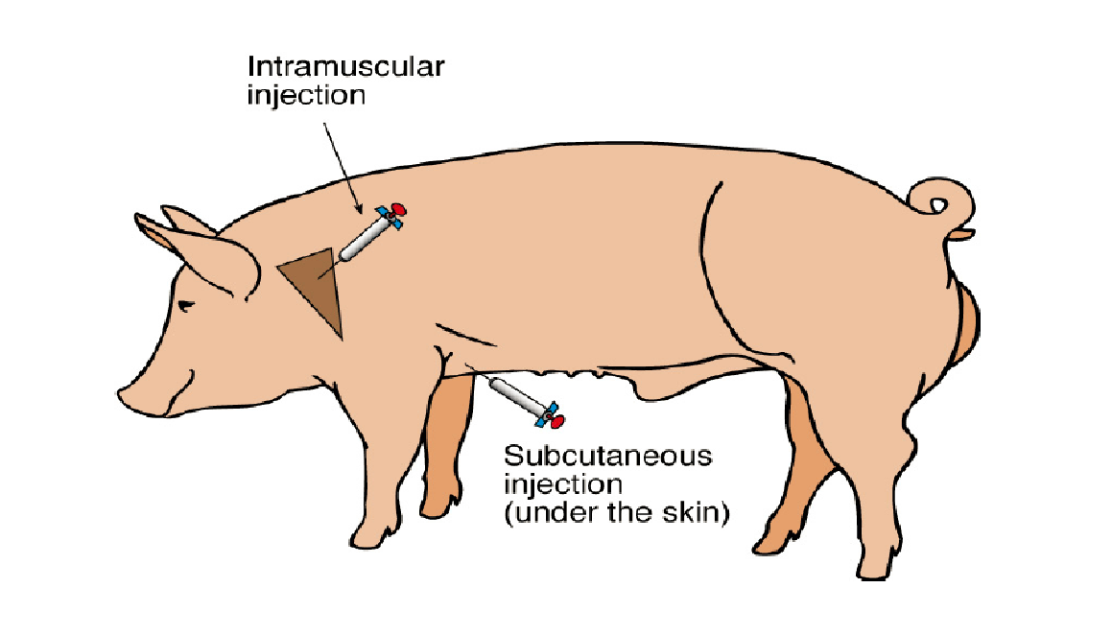
Administering meds
Main means of administering- feed, oral, injections
Before you treat, you need to determine
Diagnosis- veterinarian - www.thepigsite.com
Dosage & administration
Withdrawal
Intramuscular (IM) injections are made into the muscle.
Subcutaneous (Sub-Q) injections are injections given between the skin and muscle.
Orally- back of mouth into throat
Injection sites
Notes:
Sometimes it is necessary to administer medications to keep the pigs healthy. Usually injections or medicated feed are used.
Steps to properly administering meds
Diagnose problem- get help from veterinarian if needed- develop relationship w vet ahead of time- many vets don’t have extensive experience w swine- www.thepigsite.com has a disease problem solver where producers can enter symptoms
Determine treatment & method for administration- get proper equipment
Determine withdrawal time - this is time that it takes for the treatment to be out of the animals system when given at the proper dosage
Determine weight of animal for proper doseage
Properly restrain animal- safe for animal and handler- snare/ squeeze chute/crowding
Mark or keep records on treatment for future reference – date given/pig ID/ diagnosis/treatment used/ amount given/ withdrawal time
Oral meds
Use bolus gun or tube to administer over the back of the tongue so animal swallows
Usually used for small pigs
When using feeds
Determine weight of animals
Hand feed to control dosage
When giving injections
Avoid giving injections when possible because injection sites can cause meat quality problems
Subcutaneous (SQ)- preferred method of injection (less meat damage) -between skin & muscle- administer in loose skin between legs and body
Intramuscular (IM)- in the muscle- administer in the neck area- avoid hams and loins because of higher market value
Use new disposable syringes & needles
16 ga needles for SQ , 18ga needles for IM
No more than 5-8 ml per injection site
FOLLOW LABEL DIRECTIONS

Slide 12
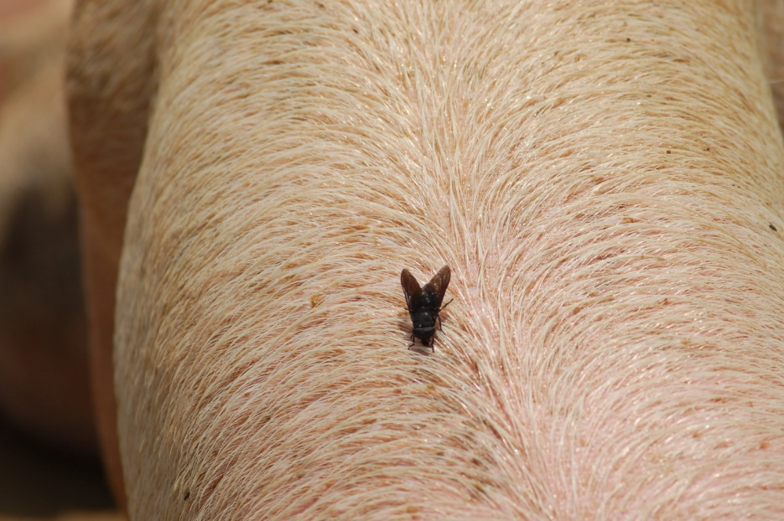
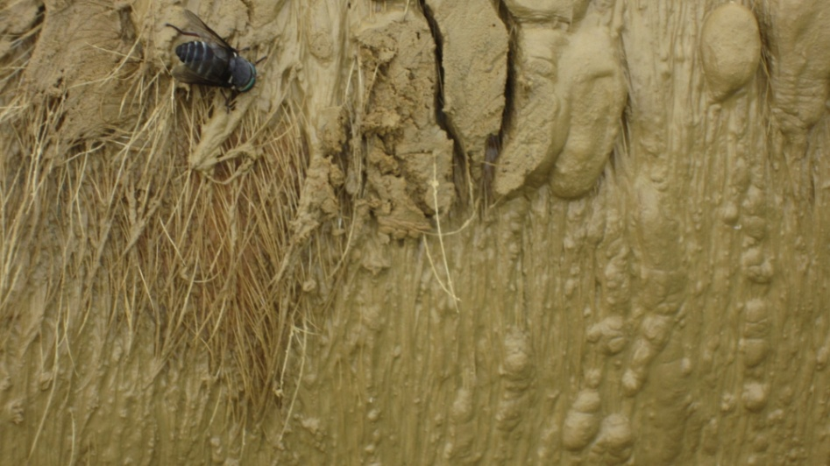
Parasites
Symptoms include: Emaciation, rough hair coat, diarrhea, coughing, vomiting, anemia, poor growth, death loss
The parasites can cause production losses, diseases, and can affect meat quality
Some parasites are difficult to control, as the eggs are highly resistant and may survive for years
Internal- Found in the digestive tract, the kidneys, liver, lungs or the blood stream
External: lice, mange, flies, and ticks
Prevention
Proper stocking density
Manage manure and pasture to break life cycle (14-21 d)
Avoid wet/ bare pasture areas
Stable fly
Horse fly
Adapted from Dr Morgan Morrow
Notes:
You can’t eradicate all parasites but the goal is to profitably manage their levels and effects
External parasites
Lice, mange, flies, and ticks
Cause reduced gain and loss of animal condition, and
they decrease production rates due to animal discomfort (e.g., skin irritation) and blood loss.
Internal parasites
Worms- round worms, whipworms, nodular worms are common
Can be identified by a veterinarian with a simple fecal sample
Treatment
Identify problem/ species
Consult vet/ extension agent to determine program for your area- marketing programs may affect options – ie- no synthetics for certain programs
Select product to use & follow label directions
Observe withdrawal period
The basic strategies to prevent internal parasite problems in pigs are sanitation, proper animal density, and rotation of pastures—the same things you would do for other species.

Slide 13
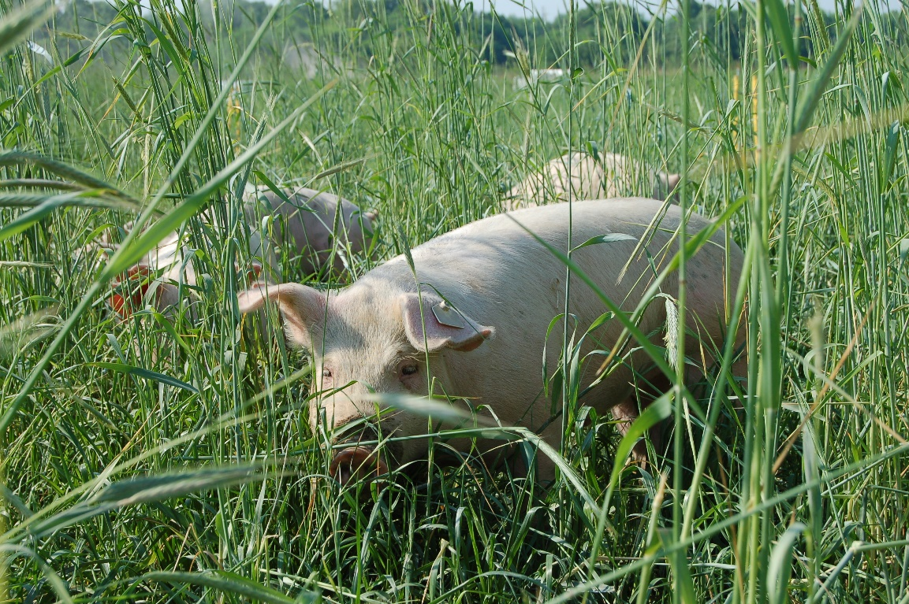
Grazing management helps controlling parasites
Provide diverse pastures (High-tannin forages such as lespedeza have been shown to reduce fecal egg counts )
Avoid overgrazing- grazing forages too short increases the intake of internal parasites
Rest periods for pastures
  - Break life cycle
Establish multispecies grazing
  - Species specific parasites

Slide 14
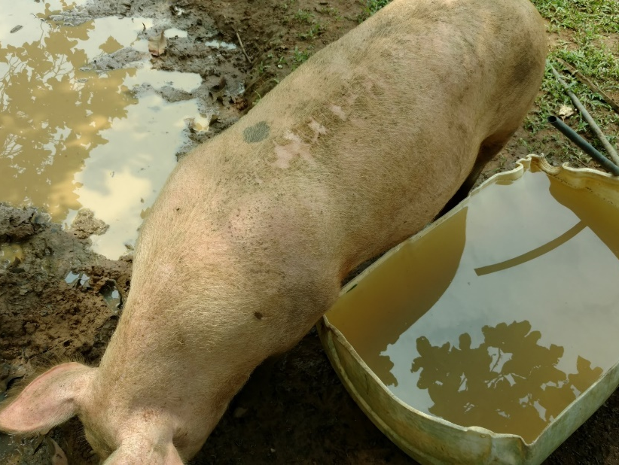
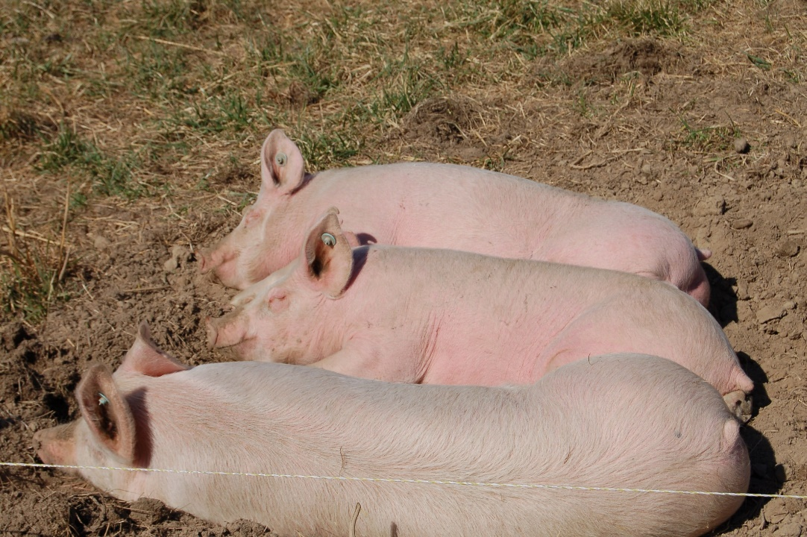
Grazing pigs can get sunburn & heat stress
Could cause:
Pain/Stress
Breeding/ Reproductive problems
Heat stress can lead to death
Provide shades
Painting white huts and shelters
Wallows
Clean, fresh water
Darker pigs are less susceptible to sunburn but may be more readily heat stressed
Notes:
Sunburn is common
Prevention-provide shade
Treatment- Provide plenty of room in shade so pigs can spread out
Heat stress
larger pigs are more susceptible
Doesn’t have to be a “hot” day. Warm temps, stress (fighting/moving/chasing), and high humidity can induce
Signs- panting, restlessness, increased vocalization, laying down and not getting up
Treatment- provide fresh water, shade, ventilation, cool down by misting w cool water
Animals usually recover within 24 hours when heat stress is detected and treated in a timely manner
Common cause of decreased fertility in boars- Testes operate as a production line with sperm at all stages of development being present at all times. If anything happens to the boar to damage this system, it can take up to eight weeks for new normal mature sperm to be produced.

Slide 15
Vermin and wildlife
Rodents, insects, birds, foxes, coyotes, snakes, wild pigs, pets
Can transmit diseases, damage the installations and equipment, and contaminate the feed and bedding
Strategies
Maintain strong perimeter fencing
Consider double fencing & buffers for sensitive areas
Avoid accumulation of organic waste- manure/ spilled feeds/ used bedding
Regularly clean and maintain feeders, feed storage and feed transport
Limit access to feed warehouses
Keep feedstuff in clean, dry and closed containers

Slide 16
Disposal of dead animals
Bury the bodies at least 6 feet deep, and cover with lime and then with soil
  The areas used for these purposes should be fenced to exclude animals
  Know soil types & properties to avoid leachate and runoff
Rendering services – can be expensive
Incineration- proper equipment
Composting- regulations

Slide 17
Sample Vaccination Schedule
 | Vaccine | Time | Dose | Booster | Dose | Withdrawl
Gilt | Farrowsure (Parvo, Ery, etc) | 4-6 weeks prior to breeding | 2ml IM | 3-4 weeks after initial vaccination | 2ml IM | 21 days
 | Prefarow Ingelvac AR4 | 5 weeks prior to farrowing | 5ml IM | 2 weeks prior to farrowing | 5ml IM | 21 days
Sow | Farrowsure | 2 weeks after farrowing | 2ml IM |  |  | 21 days
Pigs | Ingelvac AR4 | 1 day old | 1ml IM | weaning | 2ml IM | 21 days
Deworming Schedule
 | Dewormer | Time | Dose | Booster | Dose | Withdrawl
Gilts/Sows | Safeguard | Before or at breeding | 1 scoop | 1-2 weeks prior to farrowing | 1scoop | 5 days
Pigs | Ivomec .2% | 10-15 days after weaning | 20lb/Ton
 |  | for 7 consecutive days |  |  |  | 5 days

Slide 18
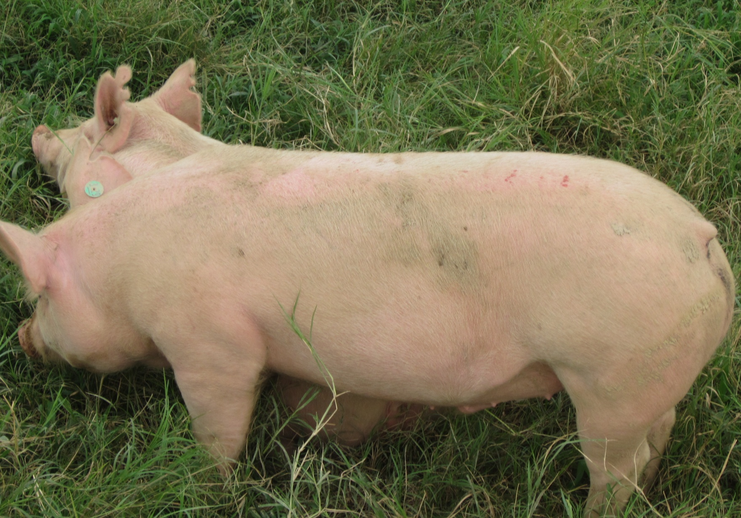
Healthy pigs = Happy pigs
A good health program is an investment and the payoff is greater potential profits

