Slide 1
Paid Experiential Learning Programs in Supporting K-14 Educators and Administrators in NC
Dr. Kathleen Liang
W.K. Kellogg Distinguished Professor of Sustainable Agriculture
Director, Center for Environmental Farming Systems
North Carolina Agricultural and Technical State University
Funding Source USDA Professional Development for Agricultural Literacy (PDAL) Program 2023-2026

Slide 2
North Carolina A&T State University does not discriminate on the basis of age, color, disability, gender,
gender identity, gender expression, national origin, political affiliation, race, religion, sexual orientation,
genetic information, veteran status, or any other basis protected by law.

Slide 3
Background
Lack of curricula about innovation and entrepreneurship related to agriculture and food systems
Lack of incentives to support K-14 teachers and administrators across all disciplines, types of schools, and special needs education models
Lack of hands-on, fun, and guided activities to engage and invigorate educators and administrators when learning about agriculture and food systems

Slide 4
Goals and Objectives
To increase the number of K-14 educational professionals trained in the agri-food system sciences via
expert-guided interdisciplinary research to enhance faculty expertise and encourage widespread implementation of educational innovation at K-14 levels;
immersive learning experiences (e.g., on-farm activities, experiential learning training) and curriculum development and teaching training for K-14 education to improve student success outcomes
continuous support, coaching, and mentorship for participants to integrate food and agricultural science concepts in their classes across disciplines to help students explore career opportunities in food and agriculture.

Slide 5
Location of the Program
North Carolina A&T State University Farm and Pavilion in Greensboro, NC
  Horticultural units
  Animal units
  Farm pavilion and conference center
  Urban agricultural innovation center

Slide 6
Priority
Our priority is to serve the K-14 schools working with budget constraints, limited resources, and rural communities in North Carolina, including teachers who support students with special needs
All disciplines are welcome
Full-time employees in rural and urban areas

Slide 7
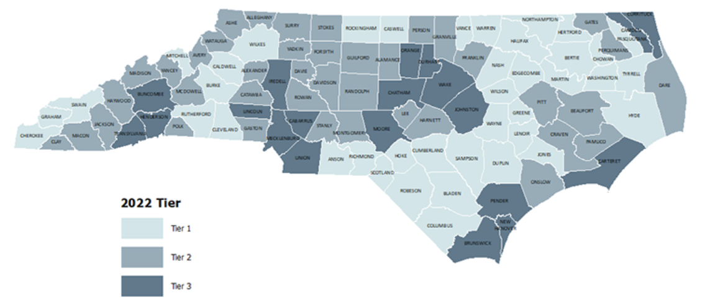

Slide 8
Logistic of the Program
Time – April 17-19 (group 1) and April 24-26 (group 2)
The proposed training is 3-day immersive learning in Greensboro, NC
Each group will consist of 15 teachers MAX
Lodging (if needed), materials and program travel are covered by grant
Each participant will receive a certificate and (stipend + Per diem) if selected to participate, and must complete the full program
Special accommodations can be arranged
Will provide letters for attendance as needed

Slide 9
Approaches
Integrated research and hands-on activities to stimulate knowledge transfer and application – work at the farm
Facilitated team works to follow the real-world work environment – shared values and responsibilities
Peer-to-peer support to mirror networking in career development
Post-program coaching and mentoring opportunities to support participants – will be scheduled in Zoom

Slide 10
Criteria to select participants
The school's need to promote and advance food and agricultural sciences
Applicant’s personal and professional development goals in advancing food and agricultural sciences via different courses and settings
Applicant’s willingness to commit time and effort to 3-day training in Greensboro
Teaching philosophy and experience
Recommendations from supervisors, peers, and students

Slide 11
Coordinate joint effort and respect participants and subject-matter experts to execute tasks
Invite and gather inputs and suggestions to fulfill the needs of diverse stakeholders
Actively Recruit and encourage participation from limited-resource communities
Respect privacy and confidentiality
Build a team and expand networks through mentorship and coaching
Provide efficient and effective services in a timely manner responding to the needs
Our Team Management Principles

